Slide 1
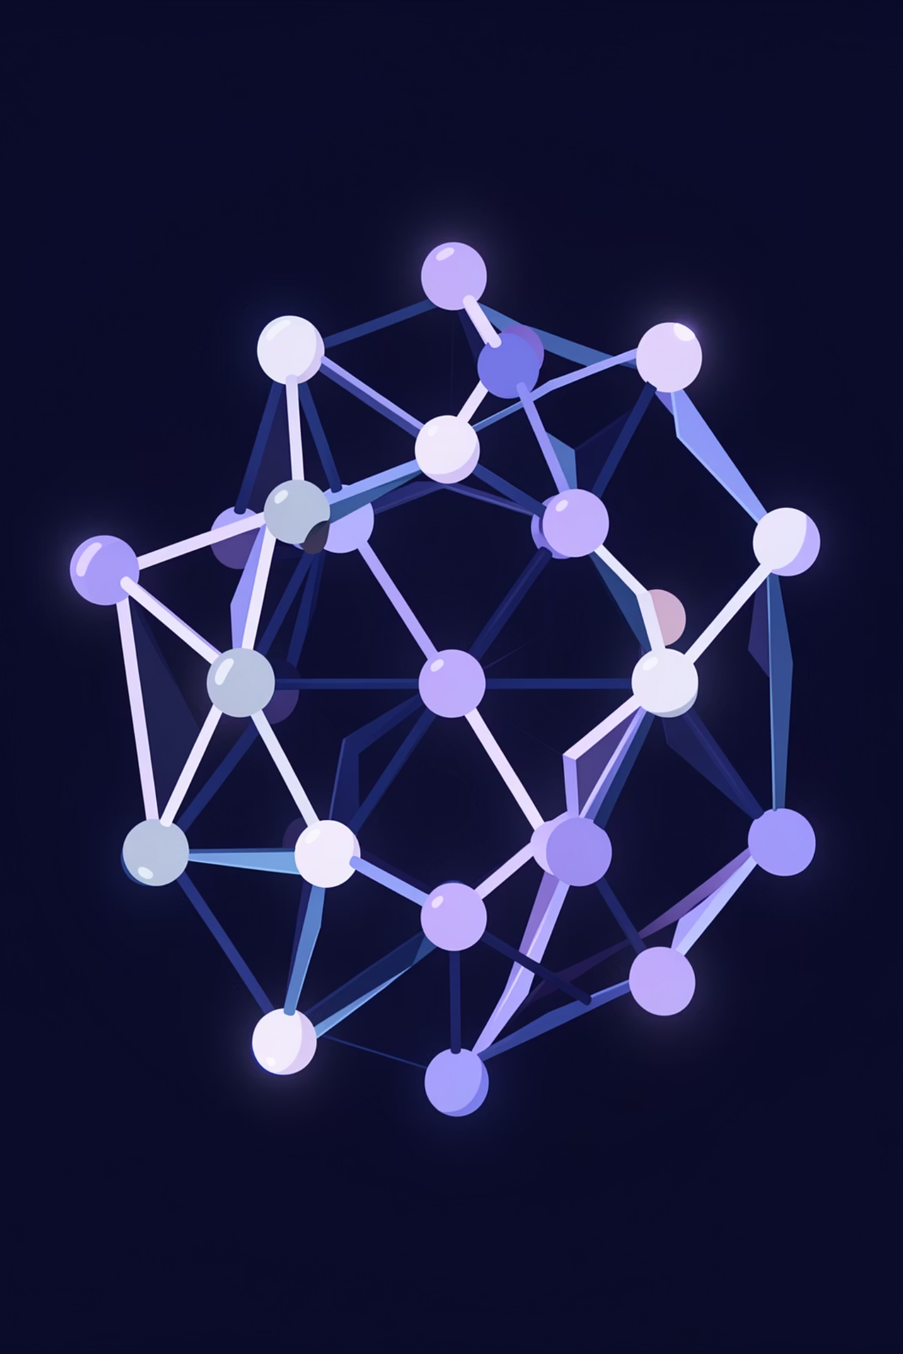
Crystal Diffusion VAE
Generative AI for Inverse Materials Design
DEEP LEARNING
MATERIALS SCIENCE
GRAPH NEURAL NETWORKS

Slide 2
Problem Statement
Discovering stable crystals with targeted properties is a difficult and resource-intensive challenge in materials science. The space of possible atomic arrangements is vast, and small changes in composition or structure can dramatically affect whether a material is stable, synthesizable, or useful for a given application.
Traditional discovery workflows rely on expert intuition, experimentation, and computational screening, but these methods are often slow, expensive, and limited in scale. Even with high-throughput simulations and lab testing, it remains hard to efficiently navigate the combinatorial complexity of crystal design while balancing multiple performance criteria.
There is a strong need for a data-driven approach that can learn from known materials and generate promising new candidates more intelligently. By proposing structures and evaluating their likelihood of stability and performance, such a system can reduce the search space and accelerate materials discovery.

Slide 3
Proposed Solution
To address these challenges, we propose an enhanced Crystal Diffusion Variational Autoencoder (CDVAE) framework that transforms material discovery from a manual search into an automated, generative process. Our solution utilizes conditional score-based diffusion to navigate the vast chemical search space, allowing for the de novo generation of 3D crystal structures based solely on a user-defined element composition. Unlike traditional methods, our model employs Annealed Langevin Dynamics to iteratively "refine" random atomic noise into stable crystalline lattices, guided by a neural network that has learned the underlying physics of the MP20 dataset. To ensure physical realism—a common failure point in earlier models—we have implemented "v4" architectural enhancements, including log-space lattice regression and automated atomic overlap penalties. Furthermore, our solution integrates a real-time validation layer that performs bonding analysis and property recomputation, providing researchers with an end-to-end platform that not only suggests new materials but also evaluates their thermodynamic stability and electronic character in seconds, effectively bridging the gap between deep learning theory and experimental synthesis.

Slide 4
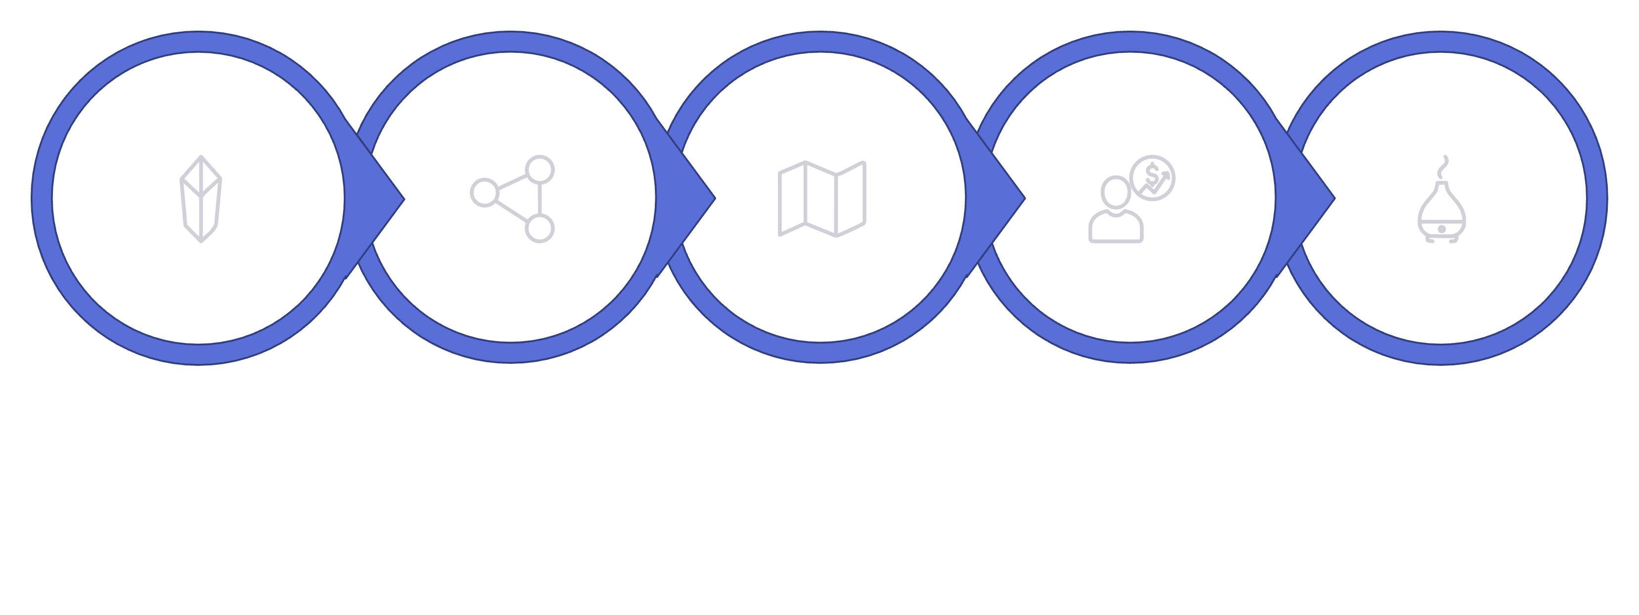

The V-Shaped Workflow
Property Predictor
Decoder + Diffusion
Input Crystal
Encoder
Latent Space
Complex crystal data is compressed to a latent point, then reconstructed into a physically valid structure via diffusion.

Slide 5
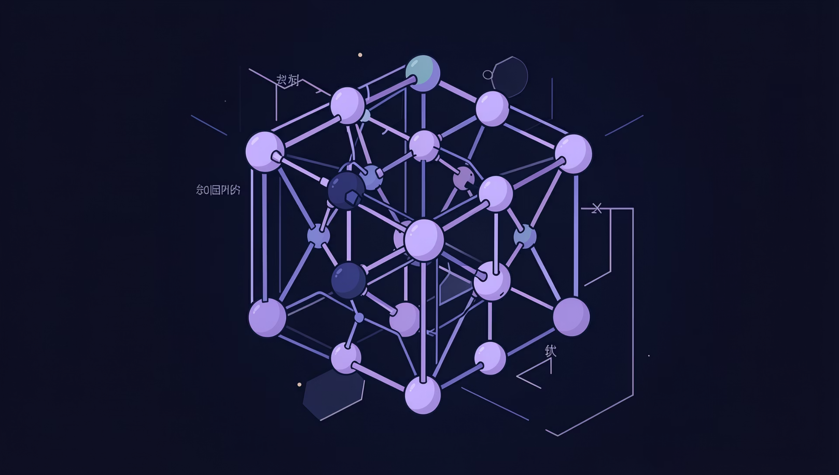
Module 1 — The Encoder
01
Input Graph
Atoms as nodes, bonds as edges
02
Periodic GNN
Cross-boundary distances via PBC
03
Feature Extraction
Atomic numbers → high-dim vectors
04
Bottleneck
Compress to μ and σ for latent sampling

Slide 6
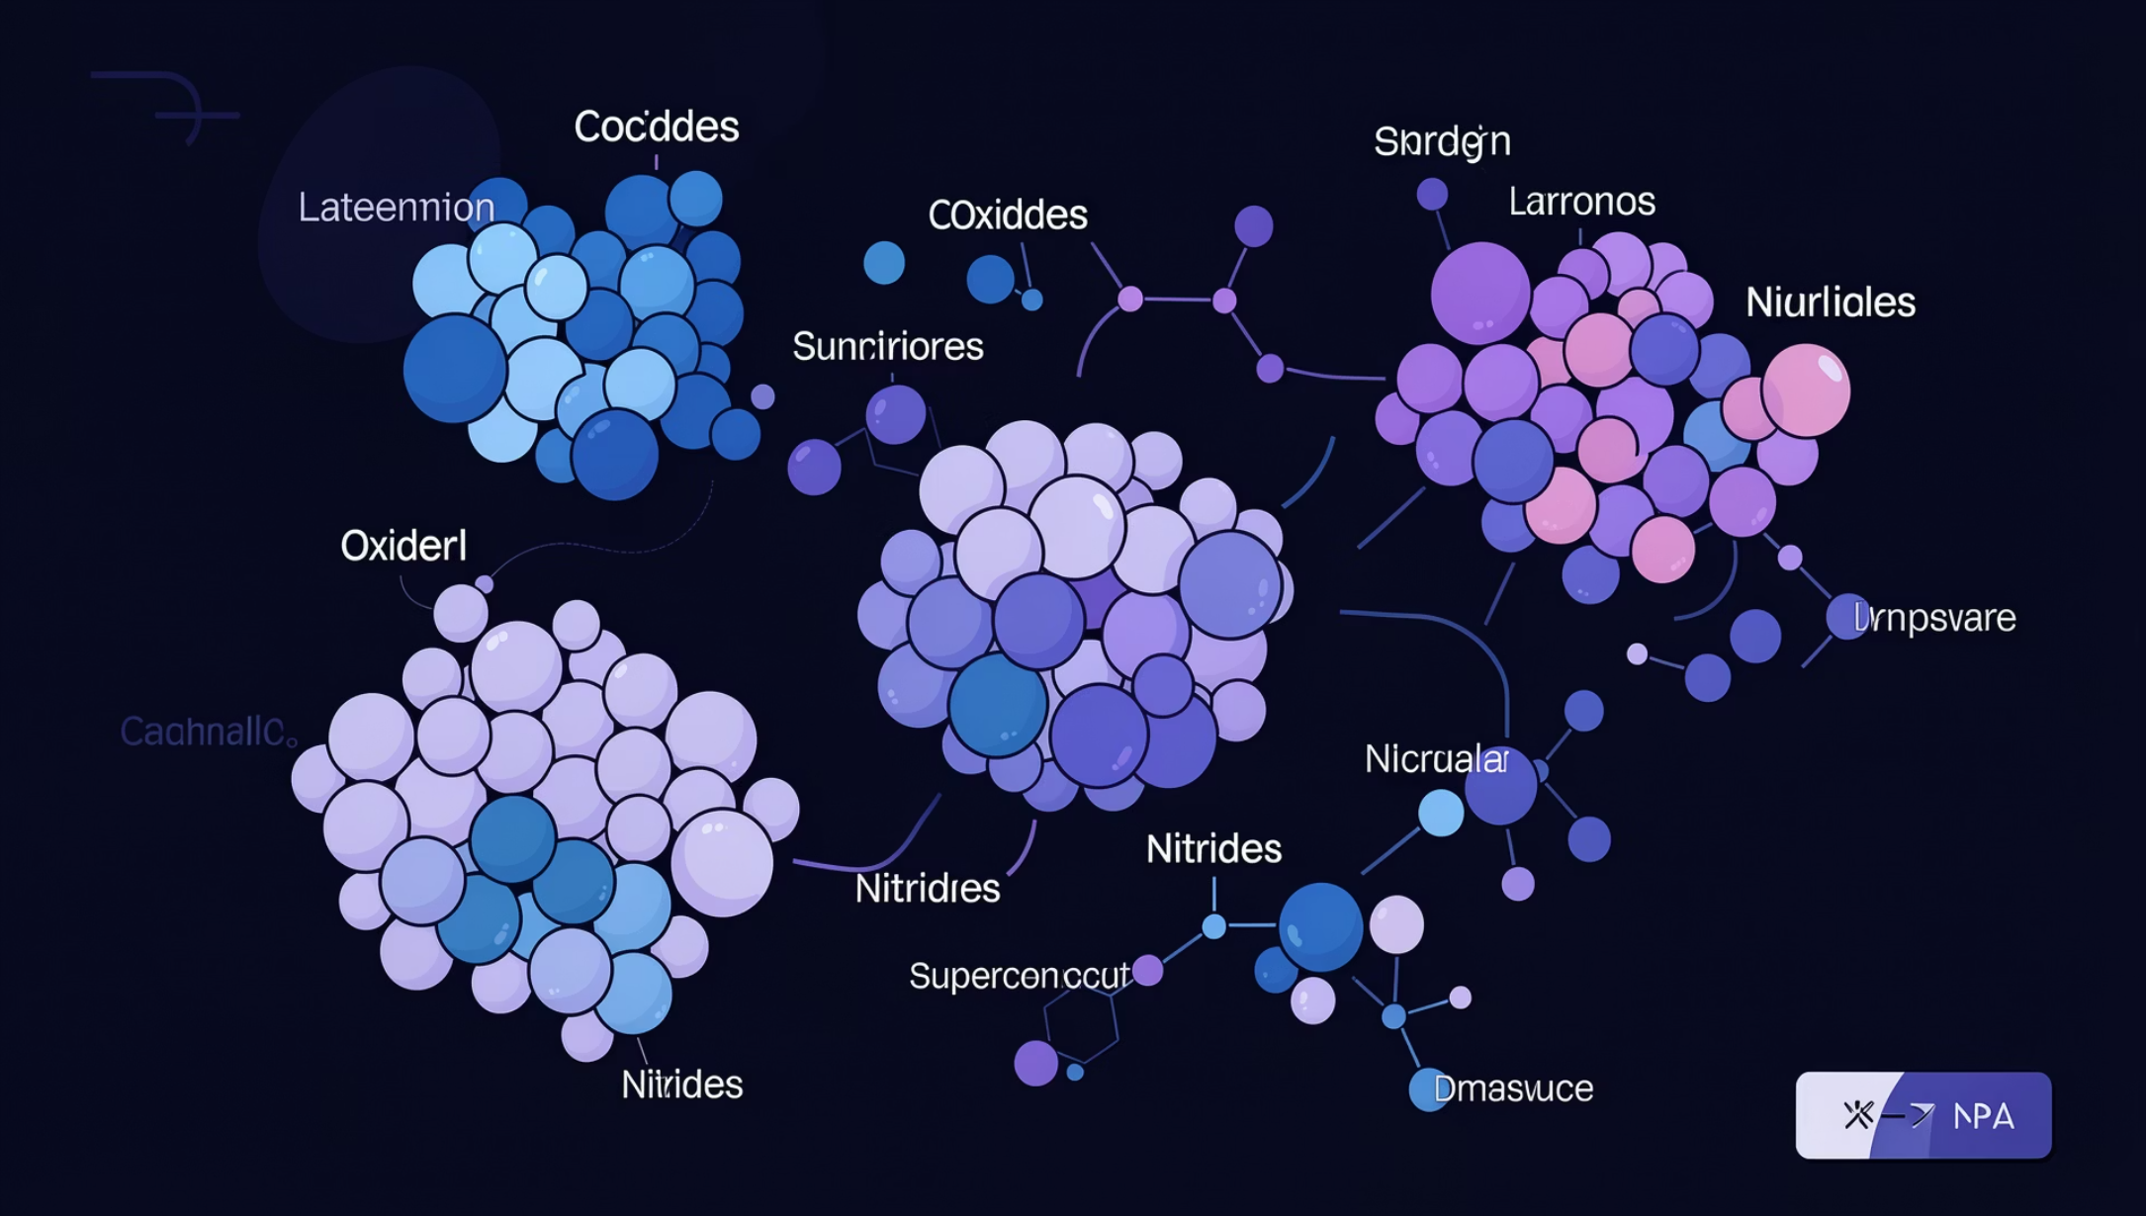
Module 2 — The Latent Space
A Continuous Chemical Map
Every point encodes a valid material. Smooth interpolation transitions between phases.
Continuous
Structured
Generative
No gaps — walk between phases
Clusters: Oxides, Nitrides, Superconductors
Sample anywhere → new material

Slide 7

Module 3 — Property Predictor
The Oracle
Predicts the material "blueprint" before decoding.
Composition
Atom count & types
Lattice Size
Unit cell dimensions
Stability
Energy above hull, band gap

Slide 8
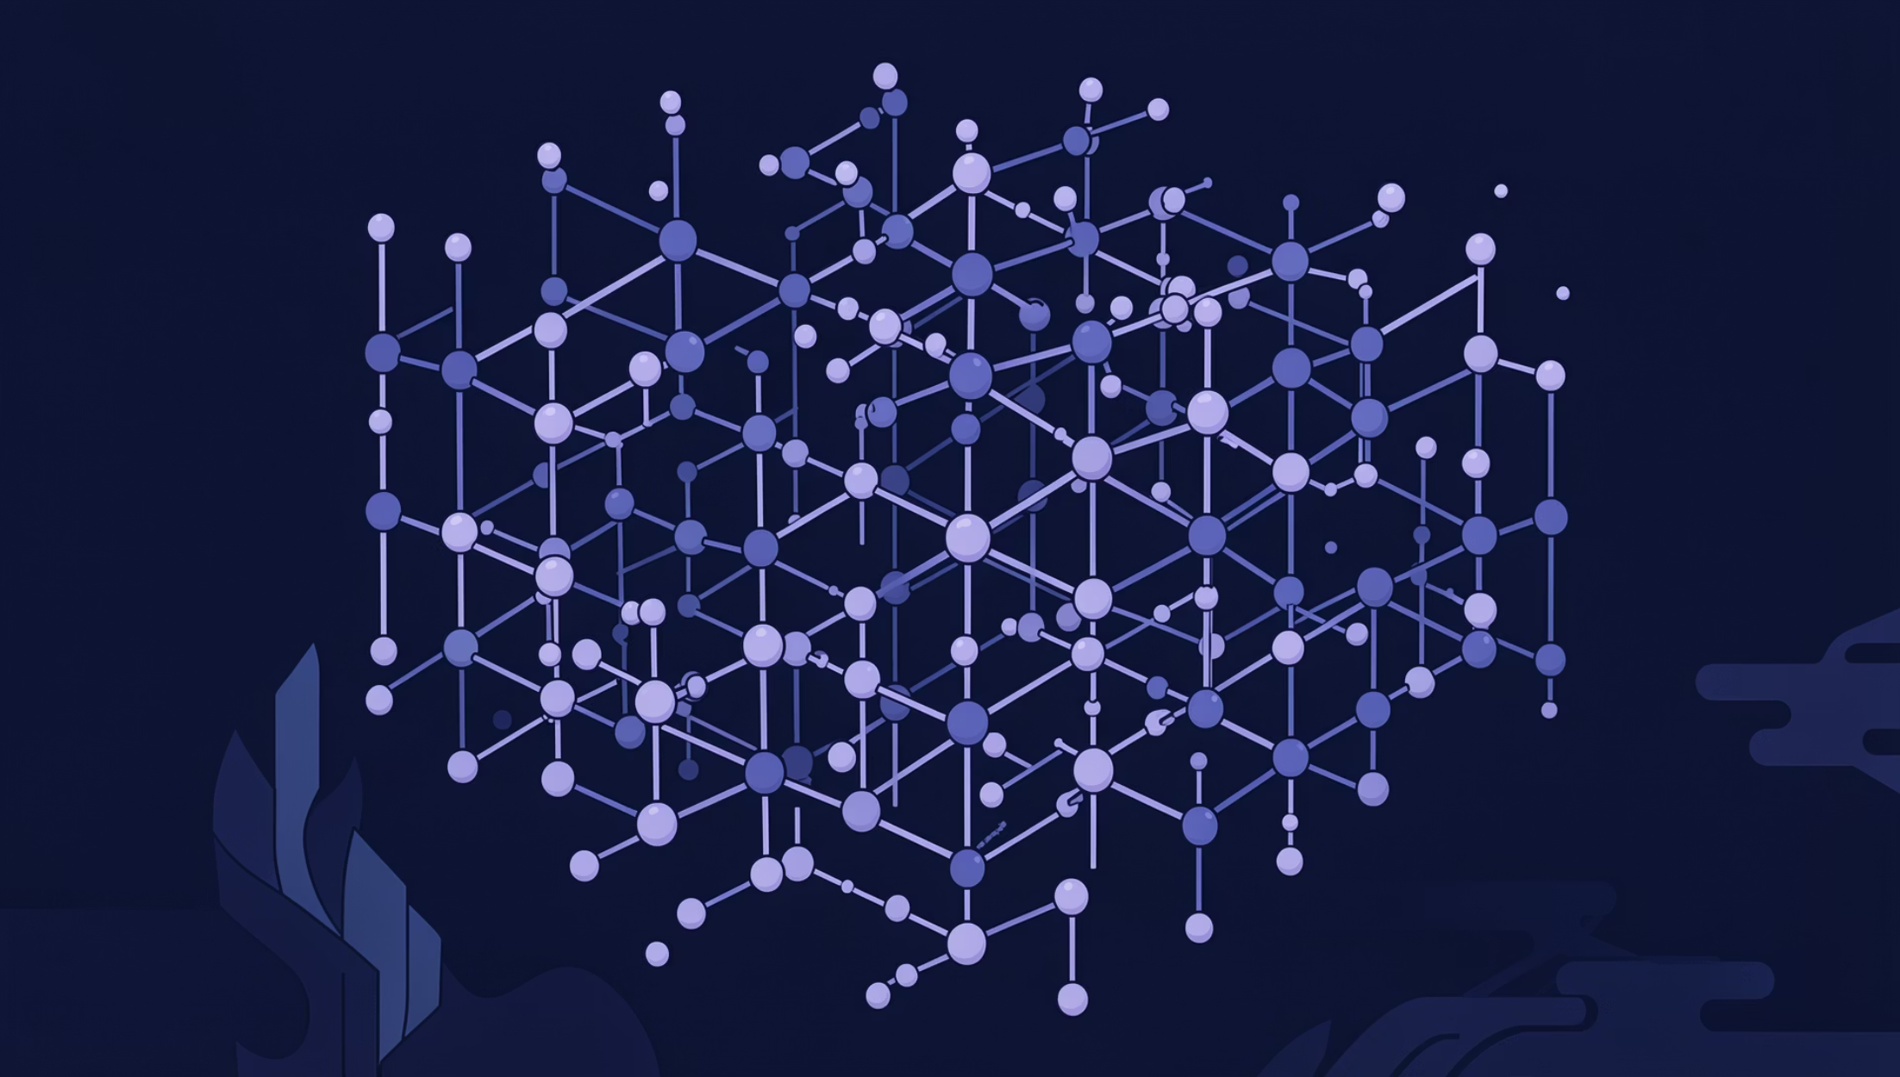




Module 4 — Decoder & Diffusion
Iterative Refinement from Chaos
Atomic Chaos
Random positions
Score Network
Gradient forces guide atoms
Langevin Dynamics
Gradual cooling, identity refinement
Valid Crystal
Stable, physically correct output

Slide 9
Libraries & Technical Stack
Core tools, workflows, libraries, and deployment infrastructure.
Main Framework & Core
Data & Numerical Computing
PyTorch — tensor math and neural networks
torch.nn.functional — activations and losses
NumPy — array math and vector ops
Pandas — tables and CSV data
scikit-learn — preprocessing and splits
Visualization
Training & Acceleration
Plotly— plots and analysis
PyTorch Lightning — training loops and GPU support
Domain Libraries
Utilities
Torch Geometric — graph neural networks
Pymatgen — CIF parsing and materials logic
ASE — atomic structure handling
tqdm — progress tracking
API & Web
Training Data
FastAPI — API endpoints
Uvicorn — app server
Kaggle — dataset source

Slide 10
Inputs, Outputs & Impact
Workflow from dataset preparation to latent representation and evaluation.
Dataset
Input
MP20 dataset — 45,000 stable inorganic crystals from Materials Project, filtered to ≤20 atoms per unit cell
CIF files processed via Pymatgen to extract 3D atomic coordinates and lattice vectors, transformed into a periodic graph (atoms as nodes, spatial proximities as edges)
Output
Metrics & Losses
Compressed latent vector (z) representing chemical and geometric identity of the material
Reconstruction Losses: Cross-Entropy for atom types, MSE for lattice/positions
KL Divergence: regularize latent space
Overlap Penalty: prevent atoms too close
Validity metrics: check if structures are physically possible
Property Prediction Accuracy: energy and band gap

